Slide 1
Cascading Style Sheets
Separating the style of you web page from the content

Slide 2
What are Cascading Style Sheets?
Allow you to specify the style of your page elements(spacing, margins, etc…) separate from the content of your document(section headers, body text, etc…)
Separating structure from content allows:
  Greater manageability
  Makes changing the style of your document easier

Slide 3
Cascading Style Sheets(CSS)
Styles are rules for describing how to display HTML elements
Styles are normally stored in style sheets
External style sheets are stored in .css files
Styles were added to HTML 4.0 to solve a problem
  Browser specific style elements
Styles can save a lot of work
Multiple style definitions will cascade into one

Slide 4
Styles solve a problem
HTML tags were originally designed to define the content of a document, i.e. headers, paragraphs tables
Browsers continued to add additional tags and attributes…(font tag and color attribute) it became impossible to separate structure from content
W3C created styles along with HTML 4.0

Slide 5
Style Sheets can save a lot of work
Suppose a style is saved in an external .css file
  By changing the .css file you can change the style of all the web pages that use that style
  You can have multiple .css files and plug in the appropriate one for a particular page

Slide 6
Multiple style definitions will cascade into one
If multiple styles are defined then the following order determines the precedence of the styles
  Inline style (inside a HTML element e.g.)
  Internal style sheet(inside the <head> tag)…applies to the whole document
  External Style sheet
  Browser default

Slide 7
Inline Styles
<HTML>
<HEAD><TITLE>Inline Styles</TITLE></HEAD>
<BODY>
<P>Some Text</P>
<P STYLE = “font-size: 20pt>More Text</P>
<P STYLE = “font-size: 20pt; color: red”>Still More Text</P>
</BODY>
</HTML>
Should be used sparingly since they mix content and structure…contrary to the philosophy of style sheets

Slide 8
Internal Styles
<HTML>
<HEAD><TITLE>Inline Styles</TITLE>
<STYLE TYPE = “text/css”>
P {font-size: 20pt; color: red}
</STYLE>
</HEAD>
<BODY>
<P>Some Text</P>
<P>More Text</P>
<P>Still More Text</P>
</BODY>
</HTML>
Use the <style> tag inside the <head>…</head> element

Slide 9
External Style Sheet
<HTML>
<HEAD><TITLE>Inline Styles</TITLE>
<Link REL=“stylesheet” TYPE = “text/css” HREF=“mystyle.css”>
</HEAD>
<BODY>
<P>Some Text</P>
<P>More Text</P>
<P>Still More Text</P>
</BODY>
</HTML>
Use the <link> tag inside the <head>…</head> element

Slide 10
External Style Sheet
External style sheet: mystyle.css
P {font-size: 20pt; color: red}
Can change the look of an entire web-site(many web-pages) by changing the external style sheet
Ensure each page links to the external style sheet using the <link> tag
Total separation of structure from content. The two can vary independently

Slide 11
Syntax
Selector {property: value}
  Selector: HTML tag
  Property: attribute
  Value: the value of the attribute
If the value contains multiple words use quotes
  p {font-family: "sans serif"}

Slide 12
Syntax
If you want to specify more than one attribute use a semi-colon as a separator
  P {font-size: 40pt; color: blue}
Grouping:
  h1,h2,h3,h4,h5,h6 {color: blue}

Slide 13
Syntax
Defining different styles for the same selector(HTML tag)
Use the class selector
  mystyle.css file:
  P.first {font-size: 20pt; color: red}
  P.sec {font-size: 40pt; color: blue}
  P.bold {font-weight: bold}

Slide 14
Syntax
HTML file
<HTML>
<HEAD><TITLE>Inline Styles</TITLE>
<Link REL=“stylesheet” TYPE = “text/css” HREF=“mystyle.css”>
</HEAD>
<BODY>
<P class=“first bold”>Some Text</P>
<P class=“second”>More Text</P>
<P>Still More Text</P>
</BODY>
</HTML>

Slide 15
Syntax
The class selector: can omit the tag name
  Result will be that all HTML tags that use the class will adopt the specified style
  .css file
    .colorblue {color: blue}
  HTML file
    <h1 class=“colorblue”>A header</h1>
<P class=“colorblue”>Some Text</P>

Slide 16
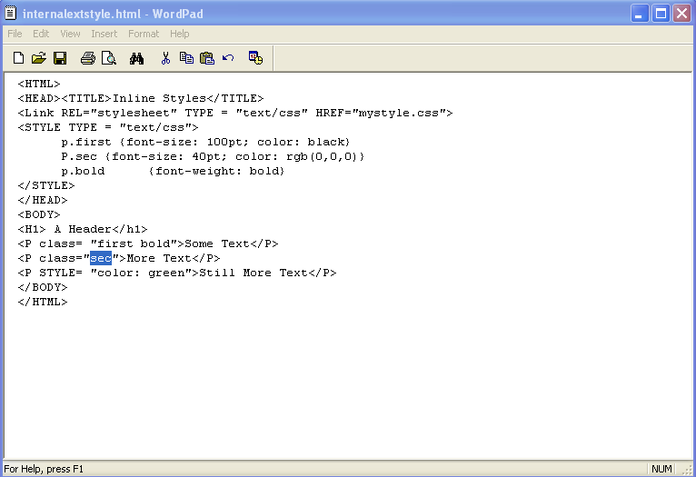
Multiple Styles

Slide 17
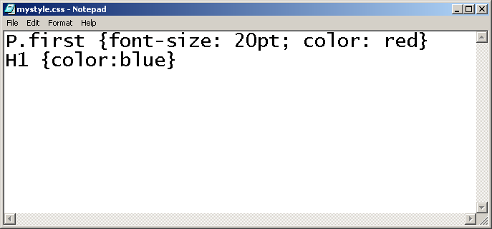
mystyle.css

Slide 18
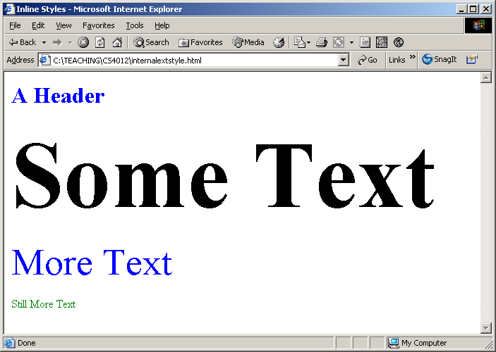
Multiple Styles

Slide 19
HTML Colours
Color Values
HTML colors can be defined as a hexadecimal notation for the combination of Red, Green, and Blue color values (RGB).
The lowest value that can be given to one light source is 0 (hex #00) and the highest value is 255 (hex #FF).
#000000 rgb(0,0,0) black
#FFFFFF rgb(255,255,255) white

Slide 20
HTML colours
W3C Standard Colour Names
W3C has listed 16 colour names that will validate with an HTML validator.
The colour names are: aqua, black, blue, fuchsia, gray, green, lime, maroon, navy, olive, purple, red, silver, teal, white, and yellow.
More info: http://www.w3schools.com/html/html_colors.asp

Slide 21
Further Information
For properties of:
  Background, text, font, border, outline, margin,
  Padding, list, table see:
    http://www.w3schools.com/css/default.asp

